Slide 1
Challenges Facing U.S. Refiners
NEMS/AEO Conference
March 18, 2003
Michael A. Lobue
Refining Issues Manager

Slide 2
Historical Petroleum Product Demand
Last Ten Years:
Annual GDP Growth: 3.3%
Petroleum Product Consumption Increase: 17%

Slide 3
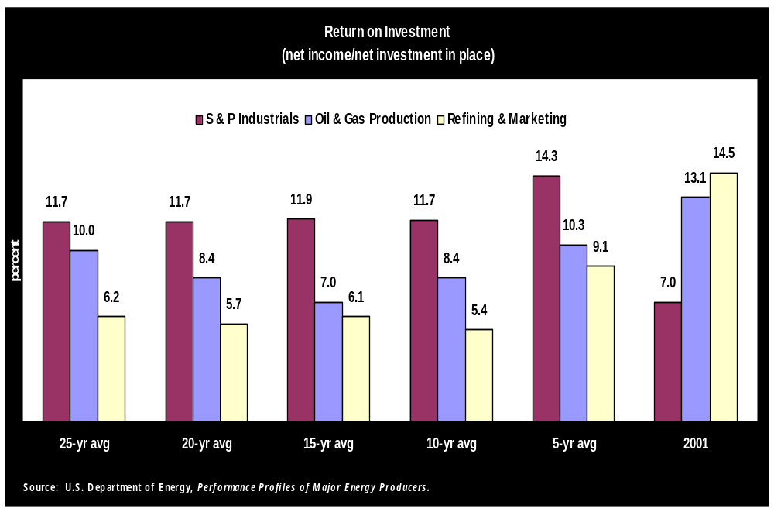

Slide 4
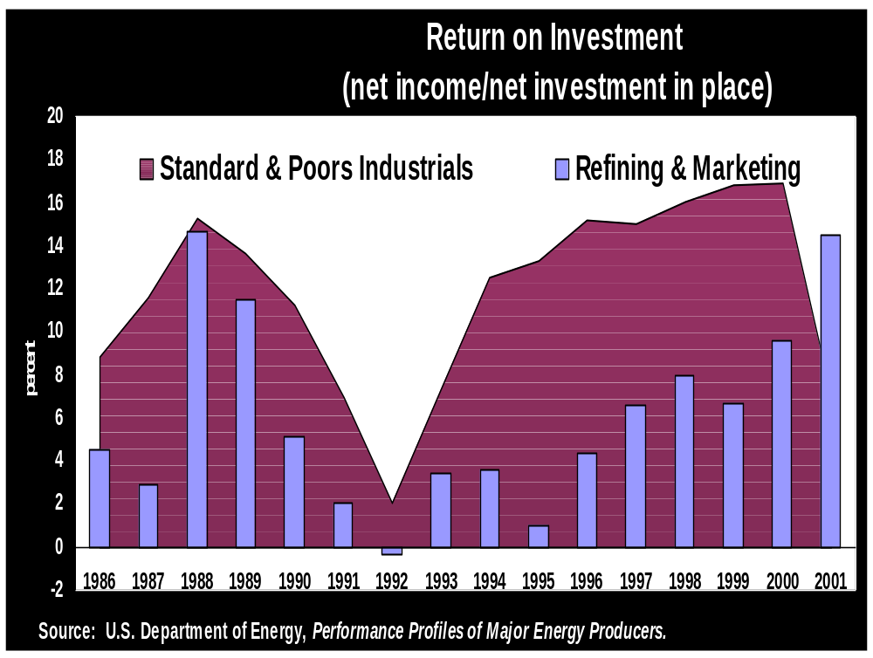

Slide 5
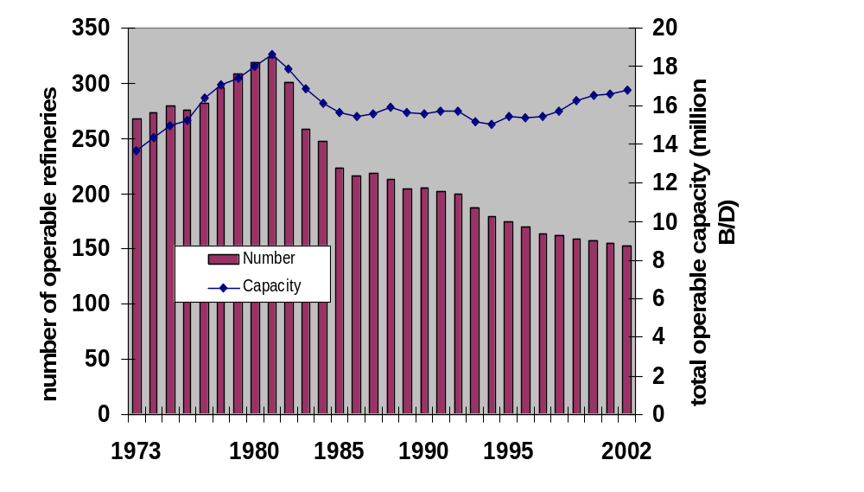
U.S. Refineries & Capacity:
1973 to 2002 (Source: U.S. EIA)

Slide 6
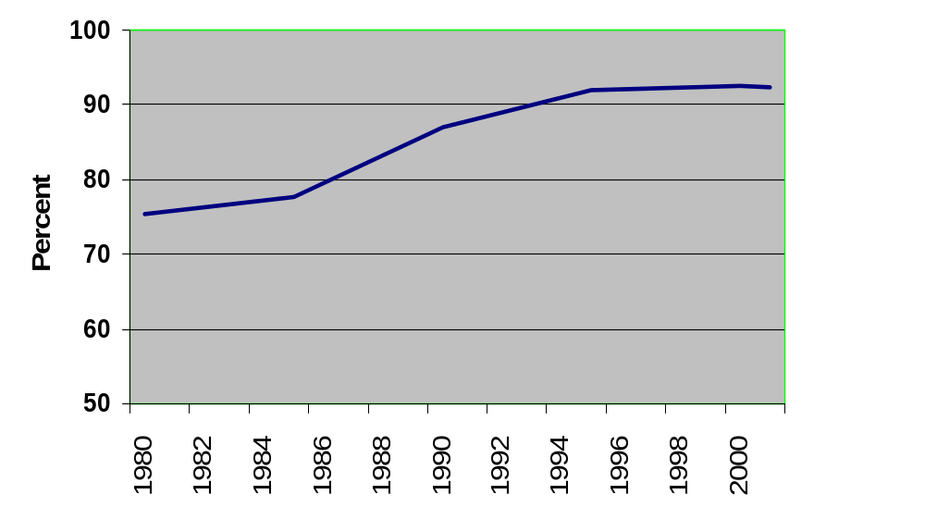
U.S. Refinery Capacity
Utilization (Source: U.S. EIA)

Slide 7
U.S. Oil & Gas Environmental Compliance Costs
1992 to 2001 Refining: $47.6 Billion
  $16.8 Billion in Capital
  $30.8 Billion in Operation and Maintenance
2001 All Segments
  $8.7 Billion
  27% of Net Income

Slide 8
Major New U.S. Refinery Environmental Costs
Gasoline Sulfur Reduction
  $8 Billion
On-road Diesel Sulfur Reduction
  $8 Billion
MTBE Removal
Off-road Diesel Sulfur Reduction
Mobile Source Air Toxics

Slide 9
On-Road Diesel Sulfur Rule
API Supports Goal
API Working with EPA to Avoid Potential Supply Problems
  Finalize Off-road Rule ASAP
  Credit Trading System Should Encourage Early Production of ULSD
  Flexible System for Distinguishing Between On and Off-Road Diesel

Slide 10
Additional Capacity Expansion Hurdles
Complex Permitting Requirements
  Federal, State, Local
    Frequently Conflicting Priorities
  New Source Review
Regulatory Uncertainty
Outdated Depreciation Treatment

Slide 11
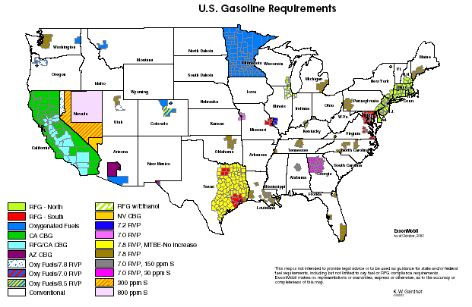

Slide 12
EIA Projections
(AEO2003 Reference Case)
Product Supplied, million barrels per day
  2001: 19.8
  2025: 29.2 (47% increase)
U.S. Refining Capacity, million barrels per day
  2001: 16.8
  2025: 19.8 (18% increase)

Slide 13
Role of Imports
Net Product Imports over Last 10 Years:
  6 to 8% of U.S. Demand
  Gasoline Imports Increased from 3.5% to 9% of Demand
EIA Product Import Projections for Year 2025 (Reference Case):
  23% of Demand

Slide 14
Conclusions
U.S. Refiners Will Make Very Large Investments to:
  Produce Cleaner-Burning Fuels
  Phase Down Use of MTBE
  Continue Reductions in Refinery Environmental Impact

Slide 15
Conclusions (cont.)
Low Rates of Return Make It Difficult for Refiners to Justify Investments
“Boutique Fuels” Reduce Refinery Flexibility and Efficiency
Very Little Excess Refining Capacity

Slide 16
Conclusions (cont.)
Economic Growth Will Result in Increased Petroleum Product Consumption
Refinery Utilization Rates Will Remain High
Availability of Additional Product Imports is Uncertain

Slide 17
Challenges Facing U.S. Refiners
NEMS/AEO Conference
March 18, 2003
Michael A. Lobue
Refining Issues Manager

